Slide 1
Sports
Improving performance through food!
Copyright 2019, SoccerCoachTV.com

Slide 2
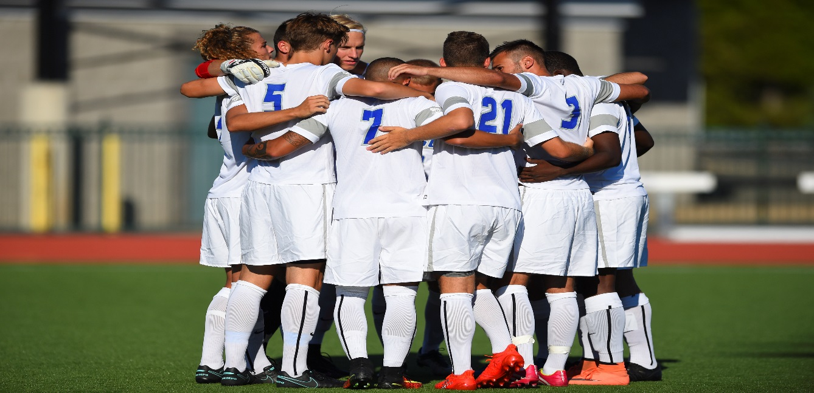
FOOD IS FUEL
Eating plenty of high quality performance foods + sport specific training + rest = WINNING ATHLETES

Slide 3
Energy requirements
How many calories do you need?
Mild training 12-14 Kcals X BW
Moderate training 15-17 Kcals x BW
Heavy training 18-24 Kcals x BW
Very heavy training 24-29 Kcals X BW

Slide 4
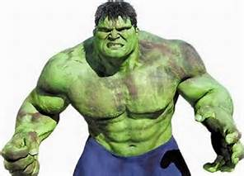
Breakdown
185 lbs athlete will need 3330 kcal a day to maintain his bw during heavy training
500 KCALs + / - to gain or lose weight a day
TOO MUCH????

Slide 5
Calories burned in 1 HR
Exercise | 150 lbs | 170 lbs | 185 lbs
Agility workout | 340 | 386 | 420
Weight lifting | 408 | 463 | 503
Soccer practice | 680 | 771 | 839
Studying | 88 | 100 | 120
TOTAL | 1516 | 1720 | 1882

Slide 6
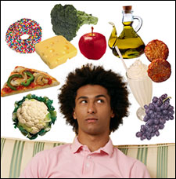
What should I eat?

Slide 7
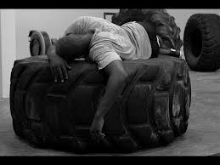
Carbs: energy provider
Provide energy
Are stored in the muscle and liver as glycogen
Glycogen stores are depleted during workouts and must be replenished
60-70% of your diet should be carbs
3-6 g per BW per day

Slide 8
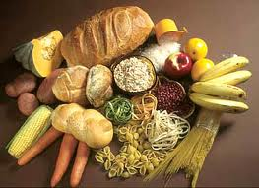
High carb foods
Whole grains: pasta, rice, low sugar cereals, oatmeal
Fruits: apples, Grapes, bananas
Veggies: Broccoli, spinach, mushrooms
Starchy veggies: Yams, Red potatoes, Beans
Dairy: yogurt, pudding, choc milk, cheese sticks

Slide 9
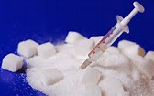
Sugar
Only need 40-60 g per day.
Is needed in the body but if excess is not used it is converted to fat.
Can actually have addiction qualities.
A challenge to reduce sugar intake but can be accomplished.
Choose healthier foods.

Slide 10
Sugar
EAT THIS
NOT THAT
Product | Sugar in g
1 Apple | 11 g
10 Strawberries | 7 g
1 Banana | 17 g
8 oz Gatorade G2 | 7 g
2 Tbs Light BBQ sauce | 3 g
1 bowl of Cheerios | 1 g
1 bowl Kashi Go Lean | 9 g
1 bar Ice-cream sandwich | 6 g
L D&D coffee skim milk | 4 g
Product | Sugar in g
20 oz Soda | 65 g
1 can of Red Bull | 27 g
20 oz Gatorade | 30 g
4 Oreo cookies | 14 g
1 pnt Ben and Jerry’s | 84 g
Cinnabon Cinnamon roll | 55 g
2 Tbs BBQ sauce | 13 g
1 bowl of Frosted Flakes | 25 g
Med Dairy Queen Blizzard | 86 g
L D&D Caramel Coolatta | 128 g

Slide 11
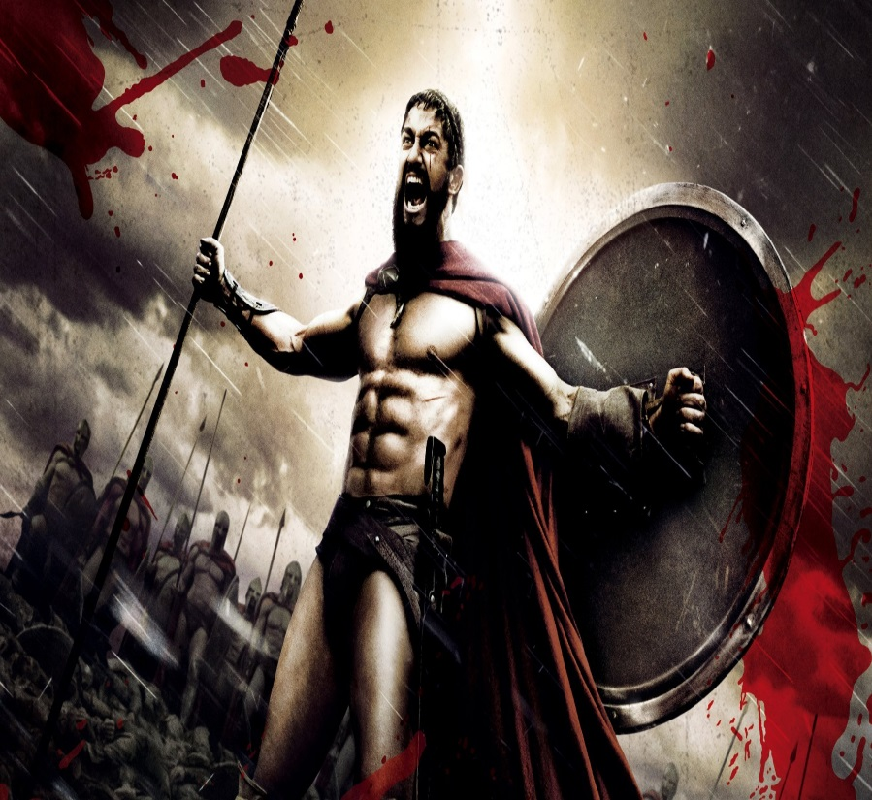
Protein: muscle rebuilder
Helps re-build and repair body’s tissues.
Not a good energy source
Avg. prot. intake of male athletes is .5 -.8 g/lbs
15-20% of diet should be from protein

Slide 12
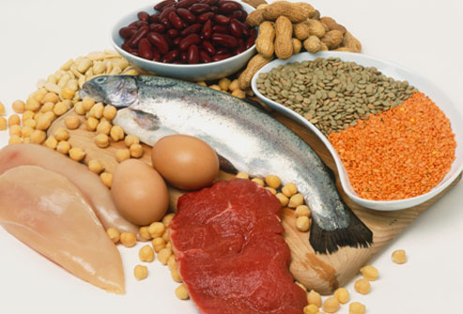
Protein: muscle rebuilder
Beef- filet, lean ground 96%
Fish – all fish (not fried)
Chicken/turkey – skinless
Eggs –1 yolk a day
Veggie burgers
Deli meats –lean turkey, ham, or roast beef
Dairy- low fat cheese or milk
Nuts and beans

Slide 13
Protein: muscle rebuilder
Grams of protein a day | 150 lbs | 170 lbs | 185 lbs
Mild | 67.5 | 76.5 | 83
Moderate | 82.5 | 93.5 | 111
Heavy | 105 | 119 | 129
Very Heavy | 127 | 136 | 148

Slide 14
Protein: muscle rebuilder
EAS whey protein 1 serving 23 g
Chocolate milk 1 container 16 g
Chicken (4oz) 35 g
Hamburger (4 oz) 30 g
Tuna (60z) 40 g
Canned tuna fish (can) 23 g
1 Egg 6 g
Yogurt (1 c) 11 g
Baked beans (1 c) 14 g
Peanut butter (1 tbsp) 4.5 g

Slide 15
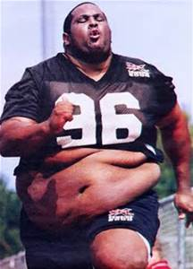
Fat: essential but in moderation
It is an energy source, transports fat soluble vit. And protects organs
High fat diet can lead to exhaustion, irritability, and increase BF
Major emphasis in athletics is to reduce BF and increase lean muscle.
15 – 30% of diet should be fat intake

Slide 16
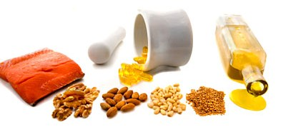
High fat foods to avoid
Avoid
Choose
Pork products – bacon sausage
Red meat
Whole milk, ice cream and cream sauce
Butter, mayo, egg yolks
French fries, hash browns and chips
Candy, cookies and cakes
Pies and pastries

Slide 17

Vitamins and minerals

Slide 18
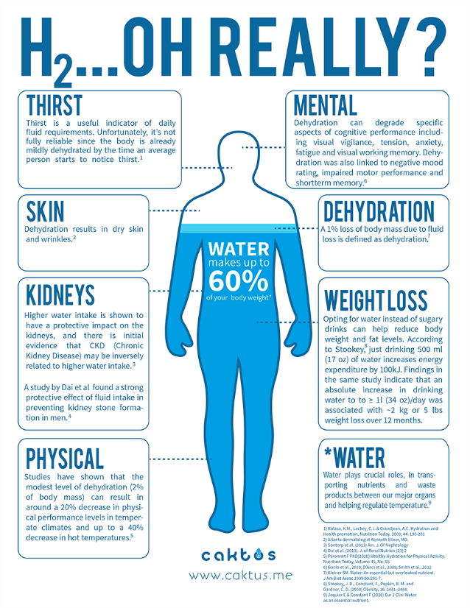
Fluids
Water is most important nutrient.
Regulates body functions , including muscle contractions
Be sure to replace fluids lost through sweat.
Water is best choice

Slide 19
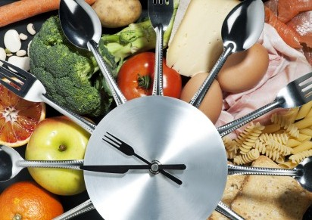
How to do it the right way

Slide 20
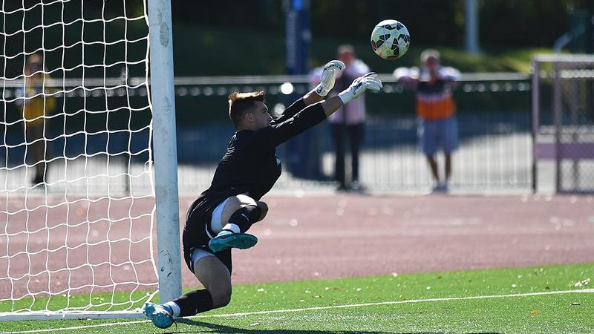
Timing
Morning Lift and Practice
6:45 am pre-workout snack
7 am lift
8:00 am pre practice snack &/or breakfast
9:30 -11:30 Practice
12:00 pm lunch
2:30 pm snack
5:00 pm dinner
9 pm snack (optional)
Meal plans Memorial Hall

Slide 21
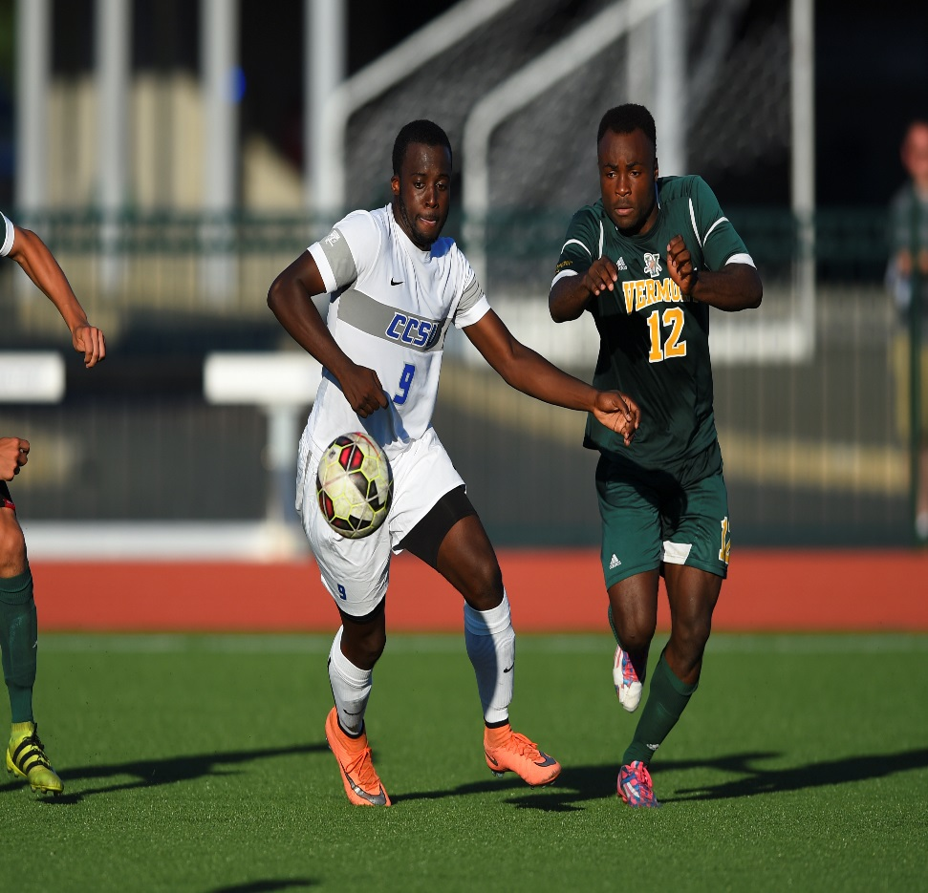
Fueling for performance
Pre-competition meal
  3-4 hours before competition
  Rich in carbs and moderate in protein; low in fat
    Pasta, rice, pizza
  During competition
  Carbs for an activity over an hour
    Sport drinks, oranges, sport gels

Slide 22

Recovery nutrition
Eat a high carb / protein (4:1) snack with-in 15 – 30 min of training. This will allow you to recover and begin re-building
Follow up with a high carb meal within 2 hours
  Bowl of cereal and fruit
  Pasta w/ chicken
  Energy bars
  Chocolate milk
  Fruit and pretzels

Slide 23
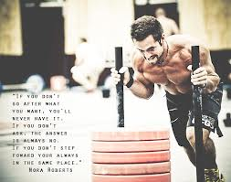
Recovery Food Carb Count
Chocolate milk 50
Bagel 50
Granola bar 30
Slice pizza 39
Banana 30
1 c rice 50
1 c pasta 34
1 c grapes 37
1 pack pretzels 50
16 oz Gatorade 28

Slide 24
SUPPLEMENTS
Most are unregulated and pose a potential positive on a drug test.
Only protein, creatine, BCAA and beta-alanine have been shown to produce positive results through peer reviewed research.
Food first always.
Any questions contact drugfreesports.com

Slide 25


Nutrition on the road
Breakfast | Item | calories
Mcdonalds | 6 oz Orange juice | 85
 | Pancakes w/ syrup | 440
 | Egg McMuffin | 300
 | Total: 825; 85% carbs
 | Reduced Fat Blueberry Muffin | 410
 | Hot chocolate | 210
 | Total: 620, 65% carbs

Slide 26


Nutrition on the road
Lunch | items | calories
 | Chicken Burrito Bowl
 | w/ brown rice, veggies and beans | 560
 | 8 oz cran-apple juice | 160
 | Total: 720 cals, 70% carbs
 | Green Goddess Cobb Salad w/ chicken – no bacon | 450
 | Low fat vegetarian black bean soup | 140
 | Plum ginger hibiscus tea | 140
 | Total: 730 cal, 65% carbs

Slide 27


Nutrition on the road
dinner | Items | calories
 | Cheese pizza, 2 slices | 500
 | Lemonade, 12 oz | 100
 | Total: 600 cals; 60% carbs
 | Minestrone soup | 90
 | Spaghetti, 2 c | 400
 | Tomato sauce, 2/3 c | 120
 | Parmesan cheese 1 T | 30
 | Roll, 2 large | 280
 | Total: 920 cal; 75% carbs

Slide 28
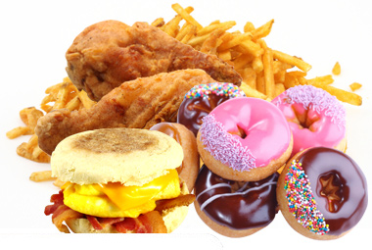
Additional resources
www.ccsudining.com/nutrition.html
Check the board outside the weight room and café
www.calorie –count.com – breaks down restaurant foods
www. Caloriecounter.com – food analysis of common foods
Smart phone apps
Know your circle of food

Slide 29
Putting it all together
Eat breakfast
Eat at the right times – maximize your performance by eating quality carbs, prot and fat every 3-4 hours during the day
Drink plenty of fluids throughout the day
After training drink or eat a recovery product with-in 15 – 30 minutes

Slide 30
Putting it all together
Be an athlete – you have unique needs as an athlete be aware and commit to fueling your body.
Timing is everything.
Be consistent with intake.
Use your support – coaches, strength and conditioning coaches and athletic trainers are all here to help you.

Slide 31

Questions??

